Slide 1
Meat & Poultry

Slide 2
Functions of Protein in the Body:
Growth and Maintenance
hair, eyes, teeth, skin, muscles, bones, every cell in your body!
Enzymes (most are proteins)
needed for chemical reactions in your body
Hormones (some are proteins)
regulate chemical conditions in the body
Antibodies (are proteins)
fight foreign invaders
Fluid Balance
-attracts and maintains water and aids in other chemical fluid levels.
Energy
Can provide energy if you do not get enough carbohydrates and fats in your diet.
This means that the protein you eat is used for energy (to keep you alive) instead of for the other main functions of growth and maintenance. ☹

Slide 3
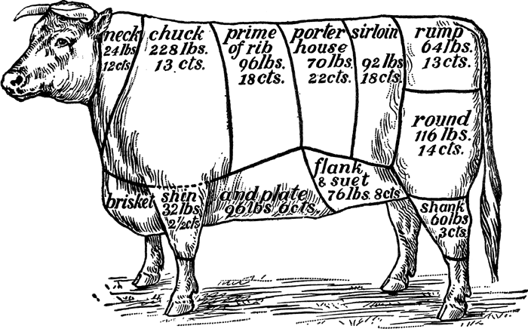
Meats
Meat comes from the muscle of the animal.
There are two types of muscles:
Muscles used to support the animal
Muscles used to move the animal

Slide 4
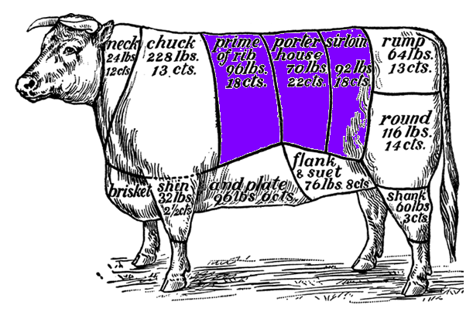
Muscles to SUPPORT the Animal
Muscles used to support the animal are:
tender, so needs to be cooked for a short period of time
flavorful because has marbled fat
expensive

Slide 5
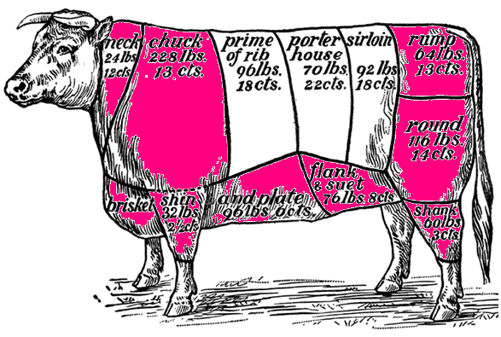
Muscles to MOVE the Animal
Muscles used to move the animal are:
tough, so needs to be cooked for a long period of time
less flavorful because has little fat
inexpensive

Slide 6
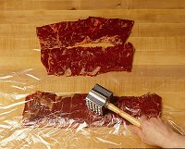
Tenderness
You can produce tenderness in less tender cuts of meat by
Marinating with acid
Pounding
Moist heat cooking
Commercial tenderizers
Grinding

Slide 7
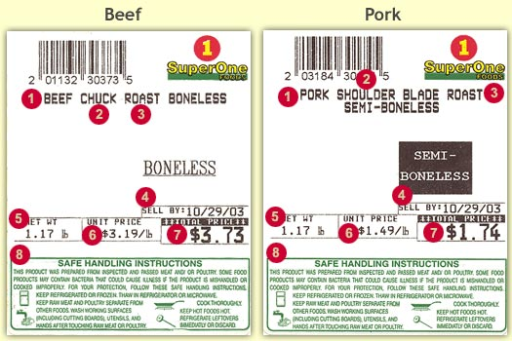
Meat Labels
The label tells three main things about the meat:
Kind of meat
Wholesale cut
Retail cut

Slide 8
Wholesale Cuts
Wholesale cuts
the part of the animal the meat came from… such as rib, sirloin, shoulder
larger cuts
Listed 2nd on label

Slide 9
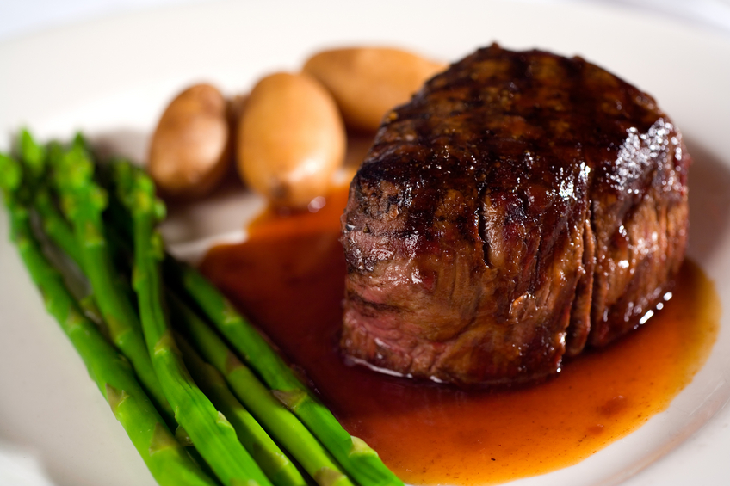
Meat

Slide 10
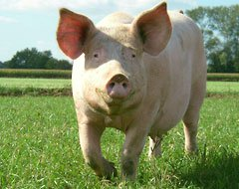
Pork:
Meat from a pig.
Mild flavor.

Slide 11
Beef: Cattle more than one year old.
Some cuts of meat are more-tender than others. The two main reasons for this are muscle movement and age.
Marbling is small white flecks of fat that melt during cooking making the meat more flavorful. Cuts with marbling are also more-tender.
Ground beef is available with different amounts of fat.

Slide 12
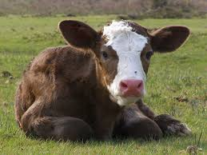
Veal: Calves (young cattle), usually one to three months old.
Mild flavor
Firm texture
Light, gray-pink color
Very little fat.

Slide 13
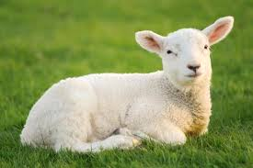
Lamb: Sheep less than a year old.
Unique
Mild flavor
Bright, pink-red color
Brittle white fat.

Slide 14
Poultry: any bird raised for food.
Most of the fat in poultry is attached to the skin.
Within poultry, there are two types of meats—white and dark. The different colors are based on the different locations and uses of the muscles.
Dark meats occur in the legs. Dark meat generally has more flavor and fat than the white meat.
White meat is generally large pieces and a mild flavor.

Slide 15
Different Types of Fowl

Slide 16
inspection & grading of meat & poultry
All meat and poultry sold in the United States must be inspected for safety and wholesomeness.
The USDA also grades meats and poultry. Grading is classifying products according to quality.

Slide 17
Grading of Meat and Poultry
Grading of meats is based on marbling, maturity, and muscle conformation.
Common Beef Grades are: Prime, Choice, and Select
Grading of poultry is based on size and quality.
Grading is voluntary and helps meatpackers market their products.

Slide 18
Preparation Techniques

Slide 19
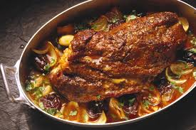
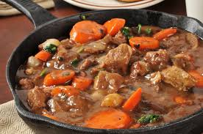
Cooking methods for less tender cuts
Braising
Stewing

Slide 20
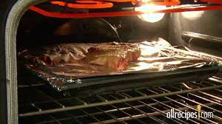
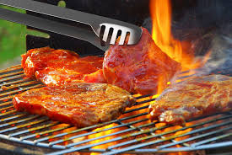
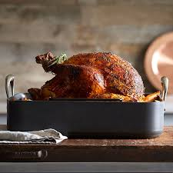
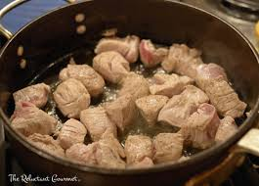
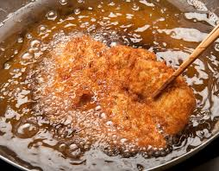
Cooking methods for tender cuts
Broil
Grill
Roast
Sauté
Fry

Slide 21
Internal Cooking Temperatures

Slide 22
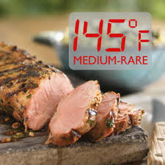
Whole meats - 145°F
Seafood
Pork
Beef
Veal
Lamb

Slide 23
Ground meats (pork, beef, veal, lamb) – 155°F
When ground meats are processed the surface bacteria can be ground and mixed throughout product. This is why it is important to cook ground products to a higher internal temperature than other cuts

Slide 24
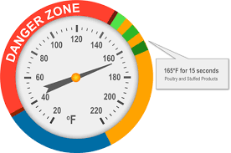
Poultry
Whole or ground
165°F

